Slide 1


Ömer Ensar DURMUŞ
14.07.2023

Slide 2

Outline
Executive Summary
Introduction
Methodology
Results
Conclusion
Appendix

Slide 3
Executive Summary
Summary of methodologies
- Data Collection
- Data Wrangling
- Exploratory data analysis with SQL and data visualization
- Building an interactive map with Folium
- Building a Dashboard with Plotly Dash
- Predictive Analysis
Summary of all results
Exploratory data analysis results
Geospatial analytics
- Interactive dashboard
- Predictive analysis result

Slide 4
Introduction
Project background and context
SpaceX launches Falcon 9 rockets at a cost of around$62m. This is considerably cheaper than other providers(which usually cost upwards of $165m), and much of thesavings are because SpaceX can land, and then re-usethe first stage of the rocket.
Problems you want to find answers
If we can make predictions on whether the first stagewill land, we can determine the cost of a launch, and usethis information to assess whether or not an alternatecompany should bid and SpaceX for a rocket launch.This project will ultimately predict if the SpaceX Falcon9 first stage will land successfully.

Slide 5

Section 1

Slide 6
Methodology
Executive Summary
Data collection methodology:
SpaceX API
Web scraping
Perform data wrangling
Discovering, cleaning and structuring data
Perform exploratory data analysis (EDA) using visualization and SQL
Discovering, cleaning and structuring data
Perform interactive visual analytics using Folium and Plotly Dash
Geospatial analytics using Folium
Perform predictive analysis using classification models
Build, tune, evaluate SVM, KNN, Decision Tree and Logistic Regression classification models

Slide 7
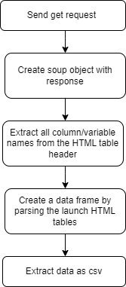
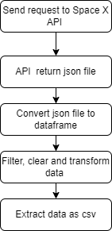
Data Collection
Data was obtained by sending a request via Spacex web API and web scraping from tables on the Wikipedia page
Web API
Web scrapping

Slide 8
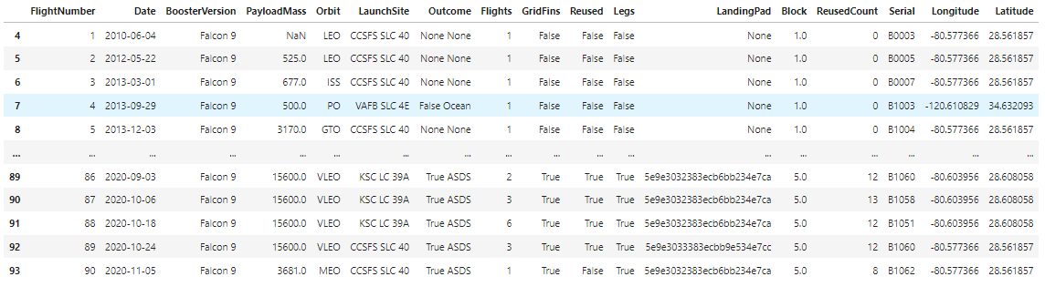
Data Collection – SpaceX API
Output
GitHub Link

Slide 9
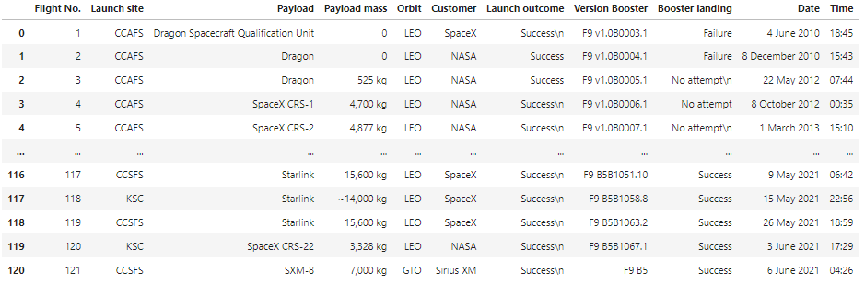
Data Collection - Scraping
Output
GitHub Link

Slide 10
Data Wrangling
First of all, exploratary data analysis was performed on the data and the unique values in the column to be estimated were examined. To make it suitable for machine learning, these values have been replaced with the number 0 and 1 representing the pass or fail state and added to the dataframe as the class column.
Import data
EDA
Define target column
Transform target column labels to number
Export data as csv
Output
Outcome
True ASDS
None None
True RTLS
False ASDS
Outcome
1
0
1
0
GitHub Link

Slide 11
EDA with Data Visualization
Scatter Chart
Flight number vs payload mass
Flight number vs launch site
Payload vs launch site
Flightnumber and orbit type
Payload vs orbit type
Bar Chart
Success rate vs orbit type
Line Chart
Success rate vs year
Scatter charts to display the relationship between two variables and observe the nature of the relationship. The relationships observed can either be positive or negative, non-linear or linear, and/or, strong or weak.
Bar charts enable us to compare numerical values like integers and percentages. They use the length of each bar to represent the value of each variable.
Line graphs are used to track changes over different periods of time.
GitHub Link

Slide 12
EDA with SQL
The SQL queries performed on the data set were used to:
Display the names of the unique launch sites in the space mission
Display 5 records where launch sites begin with the string ‘CCA’
Display the total payload mass carried by boosters launched by NASA (CRS)
Display the average payload mass carried by booster version F9 v1.1
List the date when the first successful landing outcome on a ground pad was achieved
List the names of the boosters which had success on a drone ship and a payload mass between 4000 and 6000 kg
List the total number of successful and failed mission outcomes
List the names of the booster versions which have carried the maximum payload mass
List the failed landing outcomes on drone ships, their booster versions, and launch site names for 2015
Rank the count of landing outcomes (such as Failure (drone ship) or Success (ground pad)) between the date 2010-06-04 and 2017-03-20, in descending order
GitHub Link

Slide 13
Build an Interactive Map with Folium
Mark all launch sites on a map
Initialise the map using a Folium Map object
Add a folium.Circle and folium.Marker for each launch site on the launch map
Mark the success/failed launches for each site on a map
As many launches have the same coordinates, it makes sense to cluster them together.
Before clustering them, assign a marker colour of successful (class = 1) as green, and failed (class = 0) as red.
To put the launches into clusters, for each launch, add a folium.Marker to the MarkerCluster() object.
Create an icon as a text label, assigning the icon_color as the marker_colour determined previously.
Calculate the distances between a launch site to its proximities
To explore the proximities of launch sites, calculations of distances between points can be made using the Lat and Long values.
After marking a point using the Lat and Long values, create a folium.Marker object to show the distance.
To display the distance line between two points, draw a folium.PolyLine and add this to the map.
GitHub Link

Slide 14
Build a Dashboard with Plotly Dash
Pie chart showing the total successful launches per site
This makes it clear to see which sites are most successful
The chart could also be filtered to see the success/failure ratio for an individual site
Scatter graph to show the correlation between outcome (success or not) and payload mass (kg)
This could be filtered by ranges of payload masses
It could also be filtered by booster version
GitHub Link

Slide 15
Predictive Analysis (Classification)
To prepare the dataset for model development:
Load dataset
Perform necessary data transformations (standardise and pre-process)
Split data into training and test data sets
Decide which type of machine learning model are most appropriate
For each chosen model:
Create a GridSearchCV object and a dictionary of parameters
Fit the object to the parameters
Use the training data set to train the model and find best parameters
For each chosen model:
Review the accuracy scores for all chosen algorithms
The model with the highest accuracy score is determined as the best performing model
Create feature and target dataframes
Standardize the features
Split data to train and test
Tune and train models
Calculate accuracy of models
Define best model
GitHub Link

Slide 16
Results
Exploratory data analysis results
Interactive analytics demo in screenshots
Predictive analysis results

Slide 17

Section 2

Slide 18
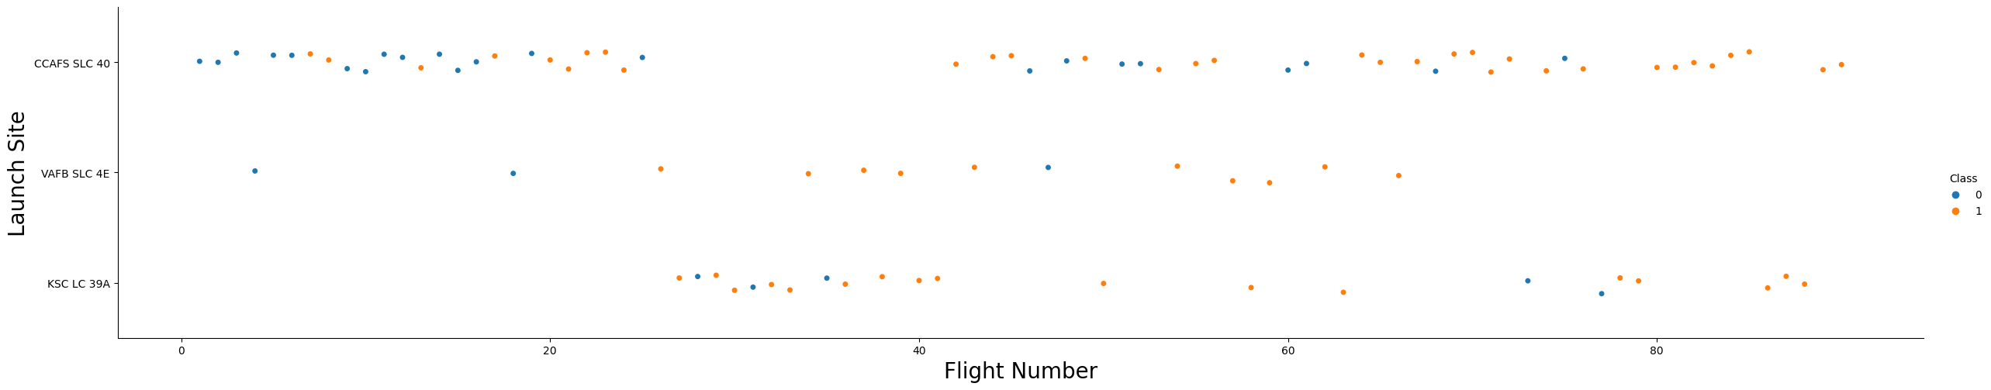
Flight Number vs. Launch Site
The scatter plot of Launch Site vs. Flight Number shows that:
As the number of flights increases, the rate of success at a launch site increases.
Most of the early flights (flight numbers < 30) were launched from CCAFS SLC 40, and were generally unsuccessful.
The flights from VAFB SLC 4E also show this trend, that earlier flights were less successful.
Above a flight number of around 30, there are significantly more successful landings (Class = 1).

Slide 19
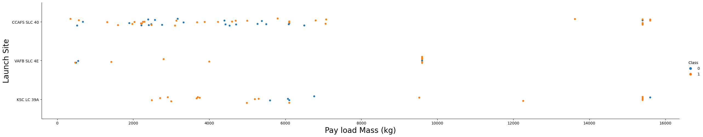
Payload vs. Launch Site
The scatter plot of Launch Site vs. Payload Mass shows that:
Above a payload mass of around 7000 kg, there are very few unsuccessful landings, but there is also far less data for these heavier launches.
There is no clear correlation between payload mass and success rate for a given launch site.
All sites launched a variety of payload masses, with most of the launches from CCAFS SLC 40 being comparatively lighter payloads

Slide 20
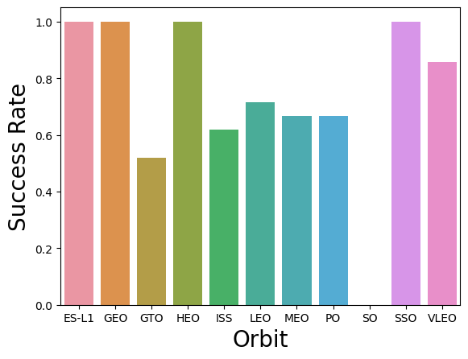
Success Rate vs. Orbit Type
The bar chart of Success Rate vs. Orbit Type shows that the following orbits have the highest (100%) success rate:
ES-L1 (Earth-Sun First Lagrangian Point)
GEO (Geostationary Orbit)
HEO (High Earth Orbit)
SSO (Sun-synchronous Orbit)
The orbit with the lowest (0%) success rate is:
SO (Heliocentric Orbit)

Slide 21
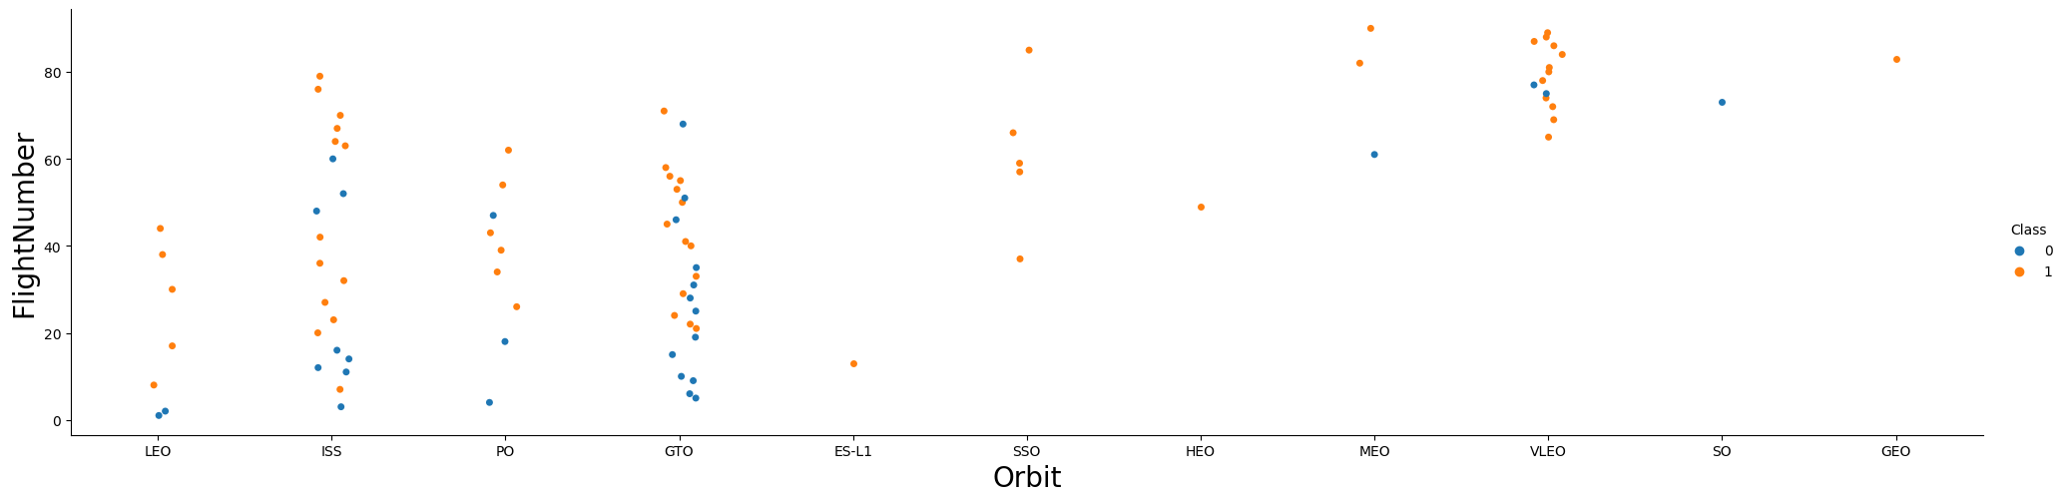
Flight Number vs. Orbit Type
This scatter plot of Orbit Type vs. Flight number shows a few useful things that the previous plots did not, such as:
The 100% success rate of GEO, HEO, and ES-L1 orbits can be explained by only having 1 flight into the respective orbits.
The 100% success rate in SSO is more impressive, with 5 successful flights.
There is little relationship between Flight Number and Success Rate for GTO.
Generally, as Flight Number increases, the success rate increases. This is most extreme for LEO, where unsuccessful landings only occurred for the low flight numbers (early launches).

Slide 22
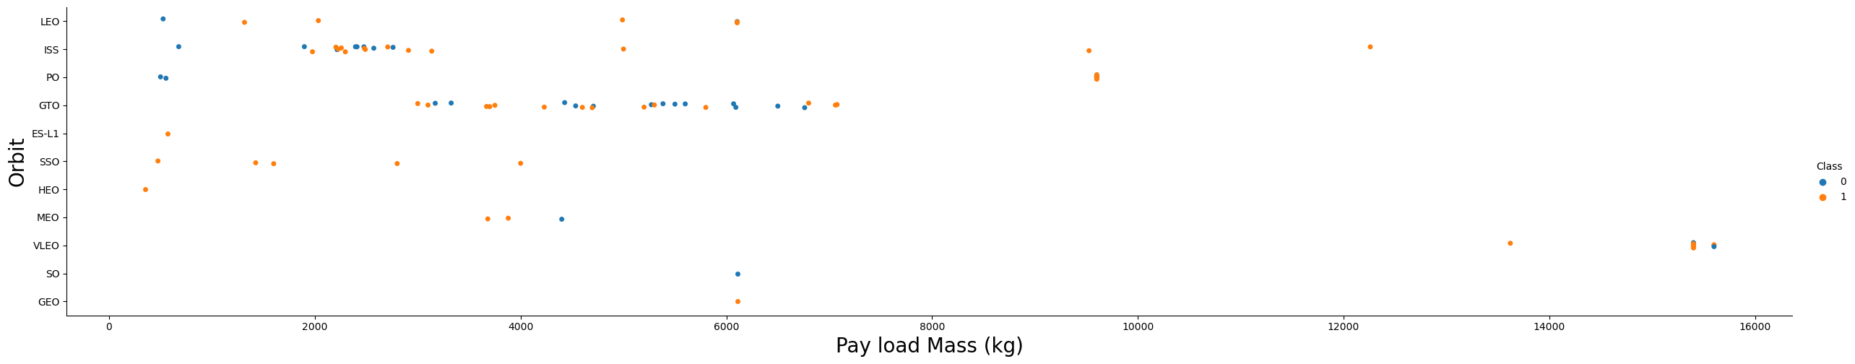
Payload vs. Orbit Type
This scatter plot of Orbit Type vs. Payload Mass shows that:
The following orbit types have more success with heavy payloads:
PO
ISS
LEO
For GTO, the relationship between payload mass and success rate is unclear.
VLEO (Very Low Earth Orbit) launches are associated with heavier payloads, which makes intuitive sense.

Slide 23
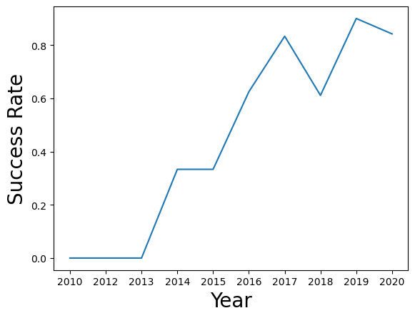
Launch Success Yearly Trend
The line chart of yearly average success rate shows that:
Between 2010 and 2013, all landings were unsuccessful (as the success rate is 0).
After 2013, the success rate generally increased, despite small dips in 2018 and 2020.
After 2016, there was always a greater than 50% chance of success.

Slide 24
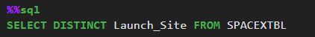
All Launch Site Names
Find the names of the unique launch sites:
The word UNIQUE returns only unique values from the LAUNCH_SITE column of the SPACEXTBL table.
Unique launch sites:
CCAFS LC-40
VAFB SLC-4E
KSC LC-39A
CCAFS SLC-40

Slide 25
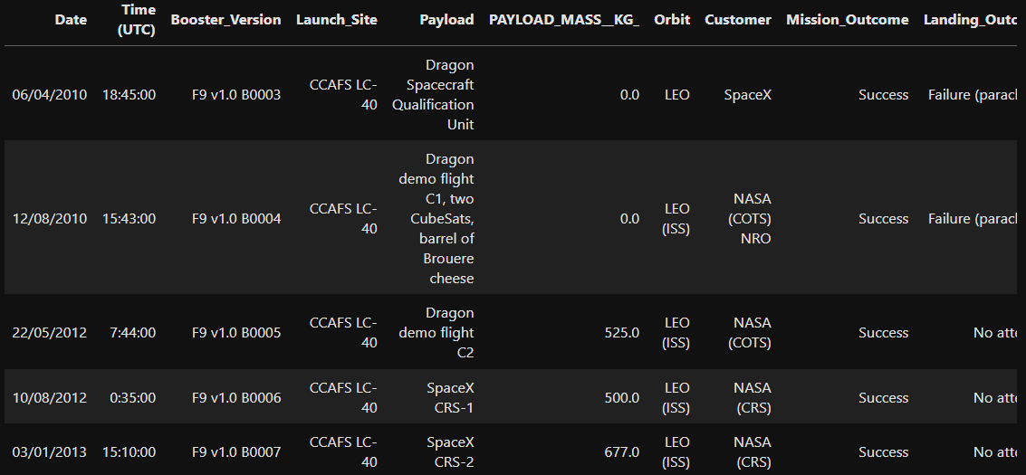
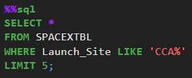
Launch Site Names Begin with 'CCA'
Find 5 records where launch sites begin with `CCA`
LIMIT 5 fetches only 5 records, and the LIKE keyword is used with the wild card ‘CCA%’ to retrieve string values beginning with ‘CCA’.

Slide 26
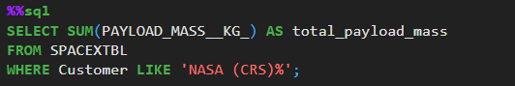
Total Payload Mass
Calculate the total payload carried by boosters from NASA
The SUM keyword is used to calculate the total of the LAUNCH column, and the SUM keyword (and the associated condition) filters the results to only boosters from NASA (CRS).
Total payload mass:
48213.0

Slide 27
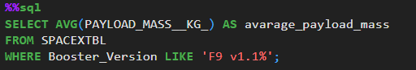
Average Payload Mass by F9 v1.1
Calculate the average payload mass carried by booster version F9 v1.1
The AVG keyword is used to calculate the average of the PAYLOAD_MASS__KG_ column, and the WHERE keyword (and the associated condition) filters the results to only the F9 v1.1 booster version.
Average Payload Mass:
2534.66

Slide 28
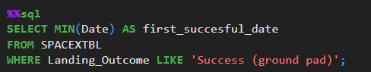
First Successful Ground Landing Date
Find the dates of the first successful landing outcome on ground pad
The MIN keyword is used to calculate the minimum of the DATE column, i.e. the first date, and the WHERE keyword (and the associated condition) filters the results to only the successful ground pad landings.
First Successful Date
01/08/2018

Slide 29
Successful Drone Ship Landing with Payload between 4000 and 6000
List the names of boosters which have successfully landed on drone ship and had payload mass greater than 4000 but less than 6000
The WHERE keyword is used to filter the results to include only those that satisfy both conditions in the brackets (as the AND keyword is also used). The BETWEEN keyword allows for 4000 < x < 6000 values to be selected.
Booster Version
F9 FT B1022
F9 FT B1026
F9 FT B1021.2
F9 FT B1031.2

Slide 30
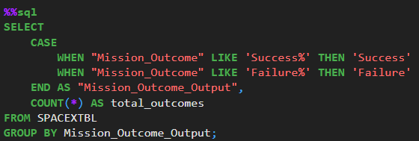
Total Number of Successful and Failure Mission Outcomes
Calculate the total number of successful and failure mission outcomes
The COUNT keyword is used to calculate the total number of mission outcomes, and the GROUPBY keyword is also used to group these results by the type of mission outcome.
Mission Outcome Output | Total Outcomes
Failure | 1
Success | 100

Slide 31
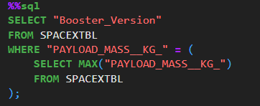
Boosters Carried Maximum Payload
List the names of the booster which have carried the maximum payload mass
A subquery is used here. The SELECT statement within the brackets finds the maximum payload, and this value is used in the WHERE condition. The DISTINCT keyword is then used to retrieve only distinct /unique booster versions.
Booster Version
F9 B5 B1048.4
F9 B5 B1049.4
F9 B5 B1051.3
F9 B5 B1056.4
F9 B5 B1048.5
F9 B5 B1051.4
F9 B5 B1049.5
F9 B5 B1060.2
F9 B5 B1058.3
F9 B5 B1051.6
F9 B5 B1060.3
F9 B5 B1049.7

Slide 32
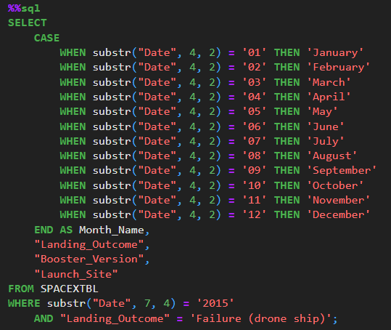
2015 Launch Records
List the failed landing_outcomes in drone ship, their booster versions, and launch site names for in year 2015
The WHERE keyword is used to filter the results for only failed landing outcomes, AND only for the year of 2015. CASE and WHEN keyword define the month name based on ‘Date’ column.
Month Name | Landing Outcome | Booster Version | Launch Site
October | Failure (drone ship) | F9 v1.1 B1012 | CCAFS LC-40
April | Failure (drone ship) | F9 v1.1 B1015 | CCAFS LC-40

Slide 33
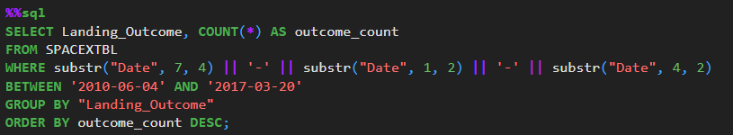
Rank Landing Outcomes Between 2010-06-04 and 2017-03-20
Rank the count of landing outcomes (such as Failure (drone ship) or Success (ground pad)) between the date 2010-06-04 and 2017-03-20, in descending order
The WHERE keyword is used with the BETWEEN keyword to filter the results to dates only within those specified. The results are then grouped and ordered, using the keywords GROUP BY and ORDER BY, respectively, where DESC is used to specify the descending order.
Landing Outcome | Outcome Count
No attempt | 9
Failure (drone ship) | 5
Success (drone ship) | 4
Controlled (ocean) | 3
Uncontrolled (ocean) | 2
Success (ground pad) | 2
Failure (parachute) | 2
Precluded (drone ship) | 1

Slide 34

Section 3

Slide 35
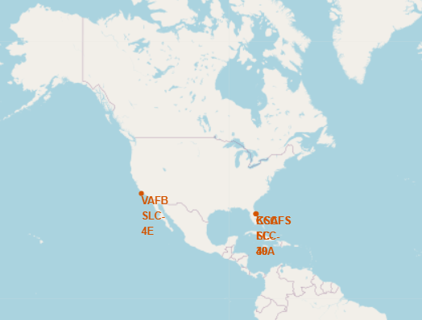
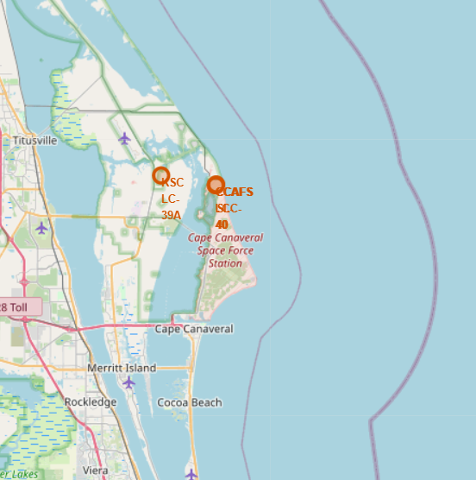
Launch Sites Locations
All SpaceX launch sites are on coasts of the United States of America, specifically Florida and California.
KSC LC-39A
CCAFS LC-40
&
CCAFS SLC-40

Slide 36
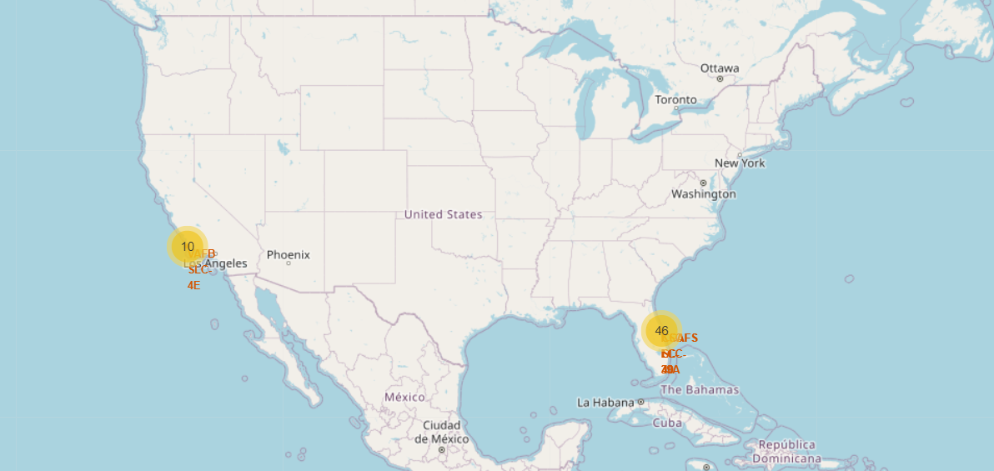
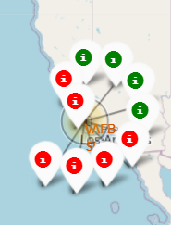
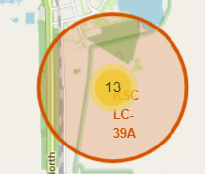
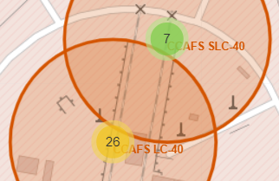
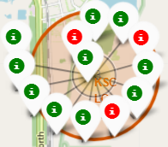
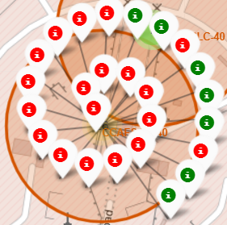
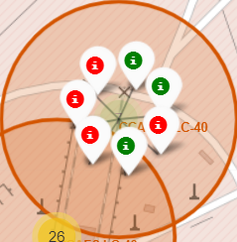
Success/Failed Launches For Each Site
Launches have been grouped into clusters, and annotated with green icons for successful launches, and red icons for failed launches.
VAFB SLC-4E
KSC LC-39A
CCAFS LC-40 & CCAFS SLC-40

Slide 37
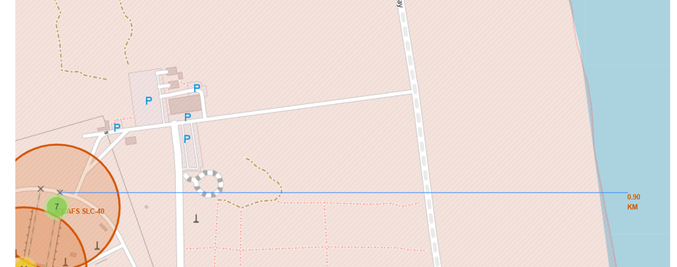
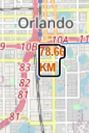
PROXIMITIES OF LAUNCH SITES TO OTHER POINTS OF INTEREST
Using the CCAFS SLC-40 launch site as an example site, we can understand more about the placement of launch sites.
The coastline is only 0.90 km due East.
The nearest highway is only 0.59km away.
The nearest railway is only 1.29 km away.
The nearest city is 78.66 km away.

Slide 38

Section 4

Slide 39
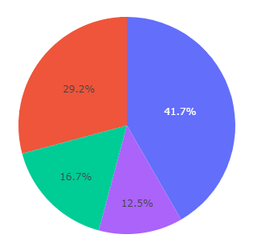
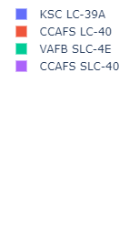
Total Success Launches by Sites
The launch site KSC LC-39 A had the most successful launches, with 41.7% of the total successful launches

Slide 40
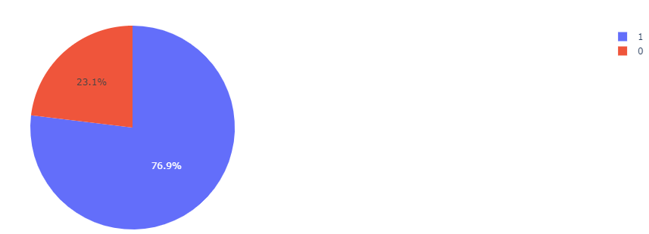
Total Success Launches Rate for Site KSC LC-39 A
The launch site KSC LC-39 A also had the highest rate of successful launches, with a 76.9% success rate.

Slide 41
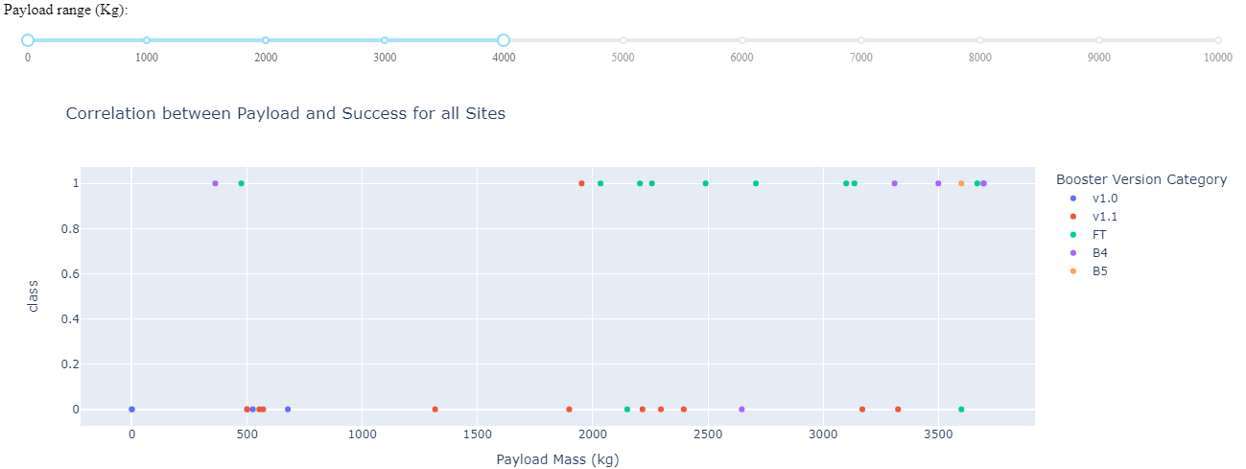
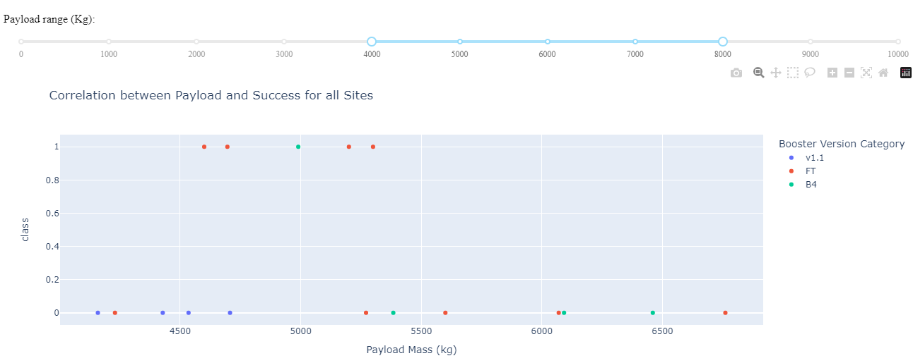
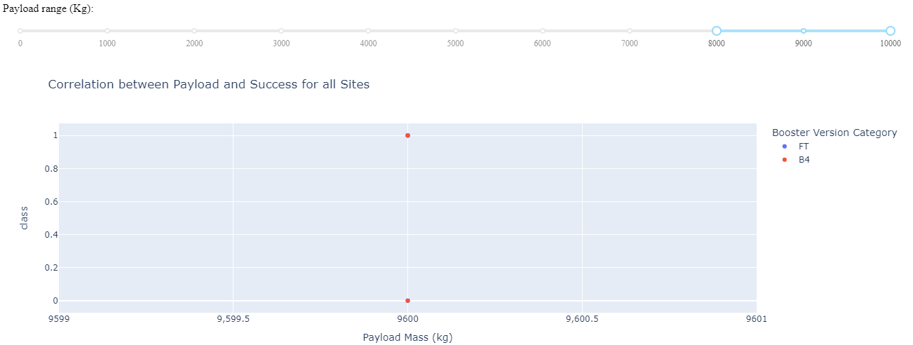
Outcome vs. Payload Scatter Plot
Plotting the launch outcome vs. payload for all sites shows a gap around 4000 kg, so it makes sense to split the data into 3 ranges:
0 – 4000 kg (low payloads)
4000 kg-8000 kg (mid payloads)
8000 – 10000 kg (massive payloads)
Some booster types (v1.0 and B5) do not start with massive and mid loads
It is seen that only FT and B4 booster versions are used for massive loads.

Slide 42

Section 5

Slide 43
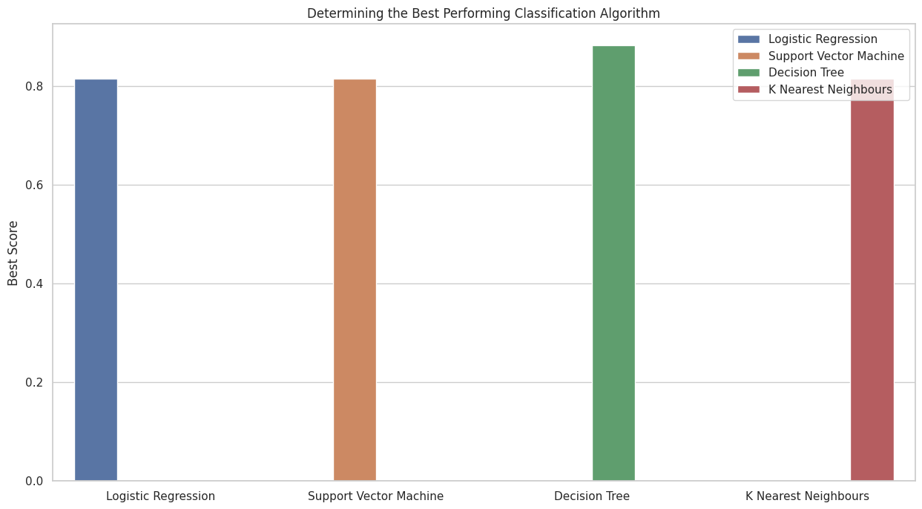
Classification Accuracy
Plotting the Accuracy Score and Best Score for each classification algorithm produces the following result:
The Decision Tree model has the highest classification accuracy

Slide 44
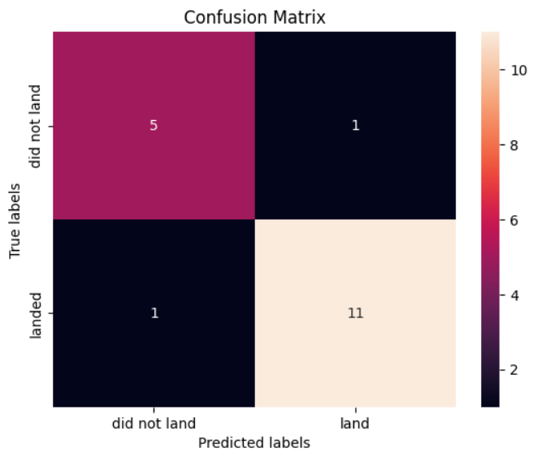
Confusion Matrix
As shown previously, best performing classification model is the Decision Tree model, with an accuracy of 88.88%.
This is explained by the confusion matrix, which shows only 2 out of 18 total results classified incorrectly (a false positive, shown in the top-right corner and false negative bottom-right corner).
The other 17 results are correctly classified (5 did not land, 11 did land).

Slide 45
Conclusions
As the number of flights increases, the rate of success at a launch site increases, with most early flights being unsuccessful. I.e. with more experience, the success rate increases.
Between 2010 and 2013, all landings were unsuccessful (as the success rate is 0).
After 2013, the success rate generally increased, despite small dips in 2018 and 2020.
After 2016, there was always a greater than 50% chance of success.
Orbit types ES-L1, GEO, HEO, and SSO, have the highest (100%) success rate.
The 100% success rate of GEO, HEO, and ES-L1 orbits can be explained by only having 1 flight into the respective orbits.
The 100% success rate in SSO is more impressive, with 5 successful flights.
The orbit types PO, ISS, and LEO, have more success with heavy payloads:
VLEO (Very Low Earth Orbit) launches are associated with heavier payloads, which makes intuitive sense.
The launch site KSC LC-39 A had the most successful launches, with 41.7% of the total successful launches, and also the highest rate of successful launches, with a 76.9% success rate.
The best performing classification model is the Decision Tree model, with an accuracy of 94.44%.

Slide 46
Appendix
Appendix can be found at the link below.
https://github.com/omerensar13/IBM_Data_Science_Exercise.git

Slide 47


